Slide 1
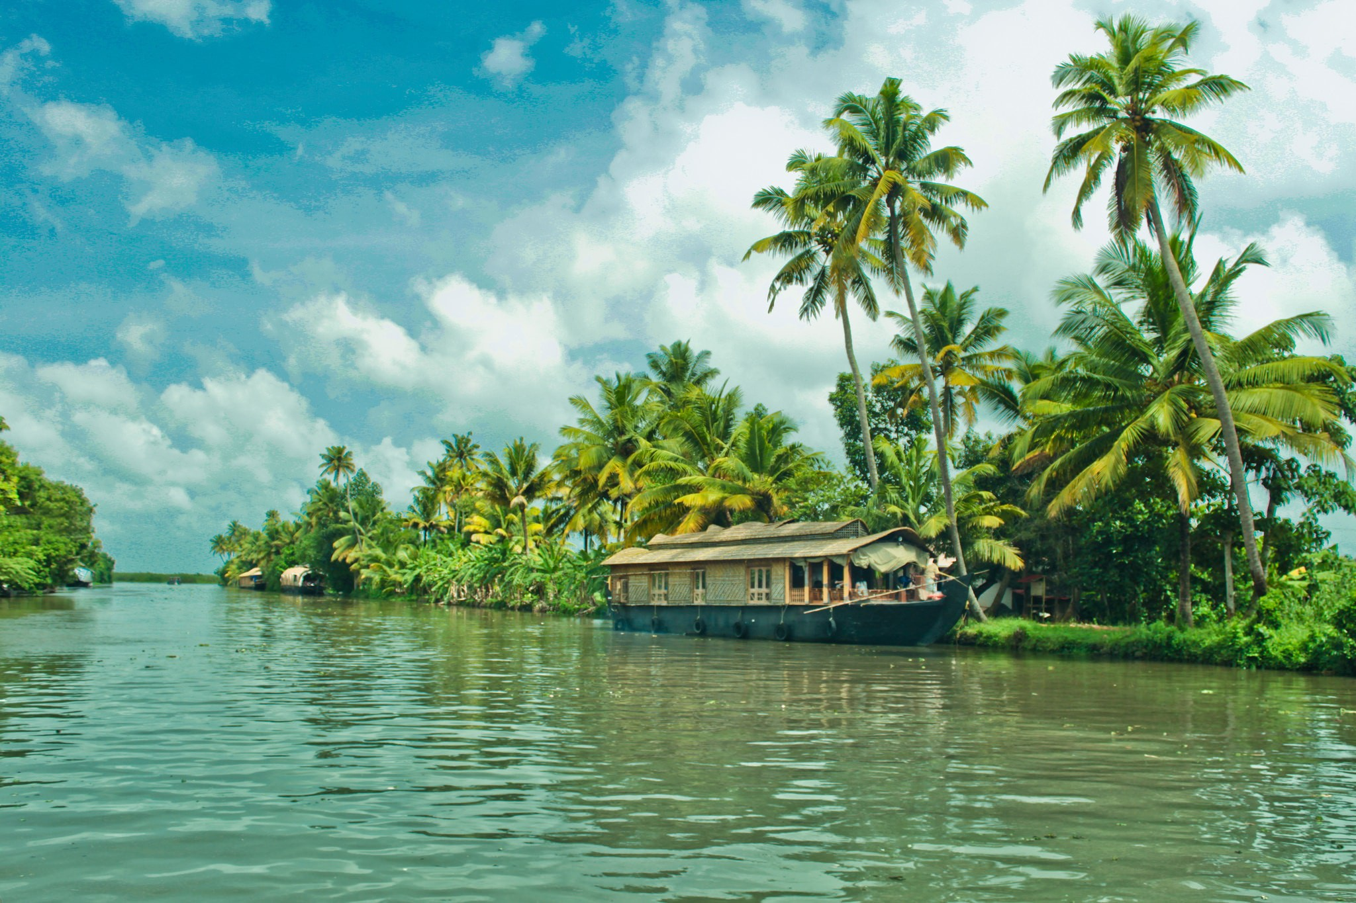
CENTRAL & SOUTH ASIA
PHYSICAL MAP

Slide 2
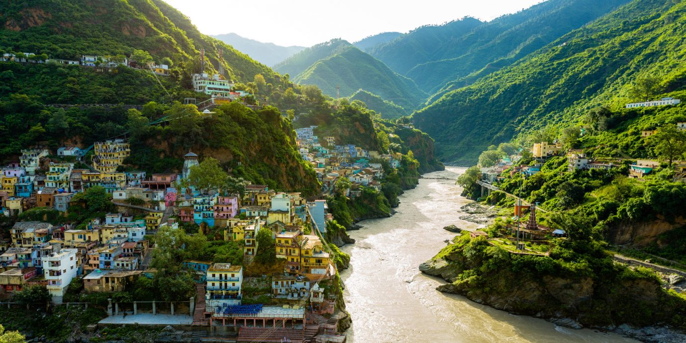
LABEL THE PHYSICAL FEATURES OF CENTRAL AND SOUTH ASIA ON YOUR MAP AND READ ABOUT THEIR SIGNIFICANCE

Slide 3
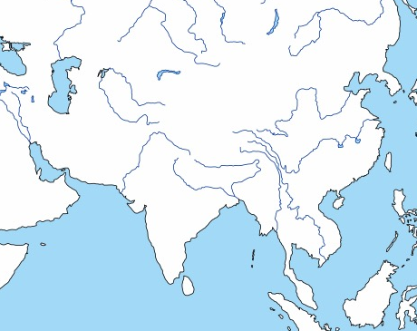
INDIAN OCEAN
Indian Ocean

Slide 4
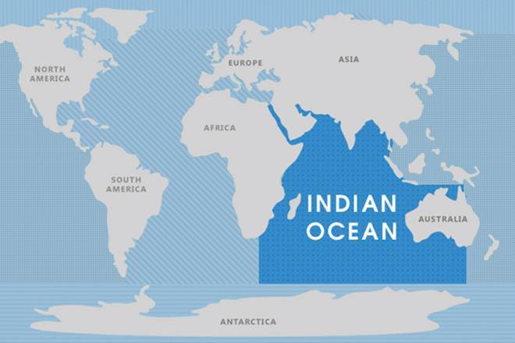
INDIAN OCEAN:
The Indian Ocean borders Asia to the south
Of the five oceans, the Indian is the third-largest. It covers approximately 20% of the Earth’s water surface area.

Slide 5
ARABIAN SEA
Arabian
Sea
Indian Ocean

Slide 6
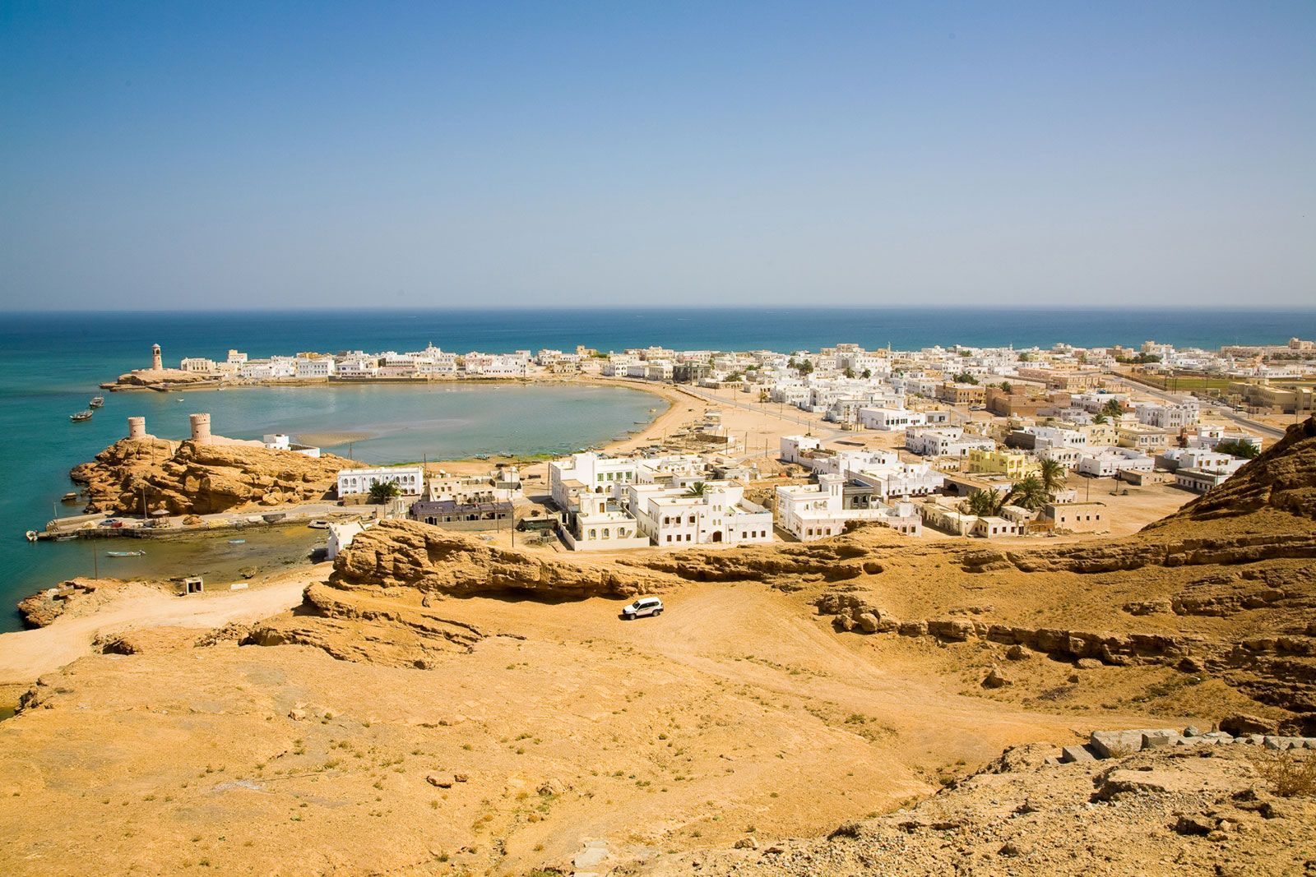
ARABIAN SEA:
The Arabian Sea is a region in the northern part of the Indian Ocean
This sea is considered one of the busiest shipping lanes in the world, primarily due to its proximity to the Red Sea and the Persian Gulf. Most of the ships that use the Arabian Sea for transportation purposes are large tankers.

Slide 7
BAY OF BENGAL
Arabian
Sea
Bay of Bengal
Indian Ocean

Slide 8
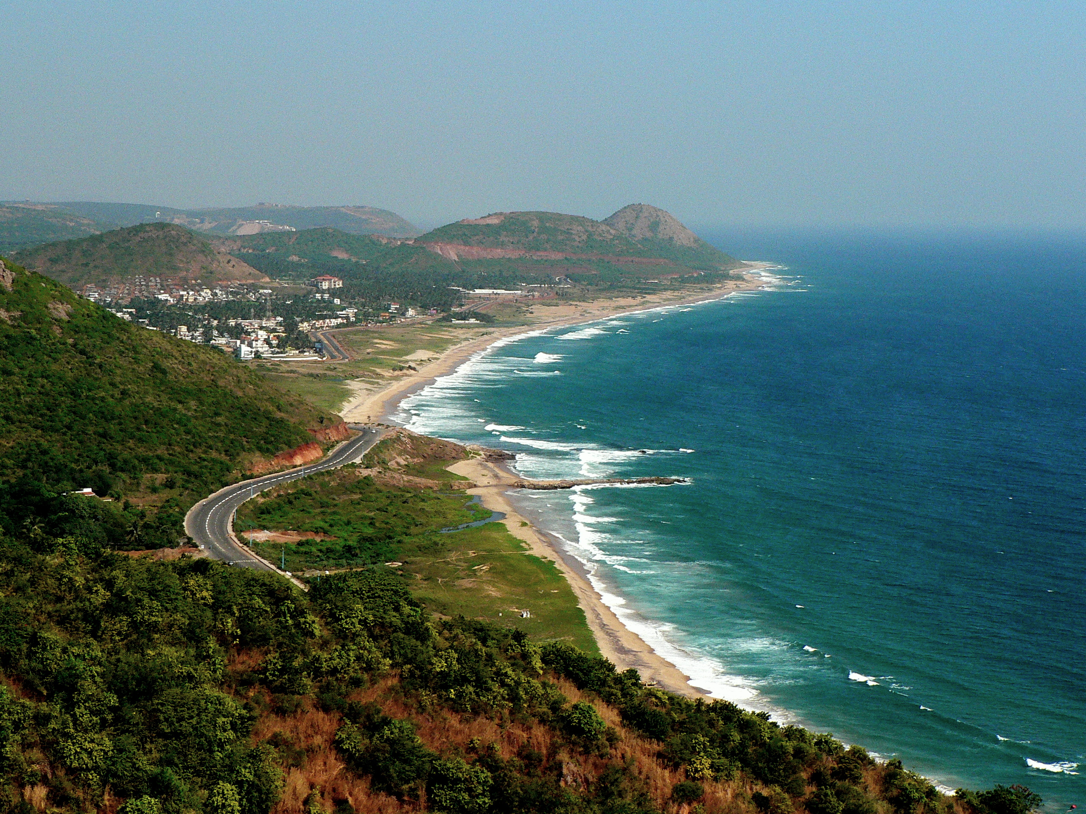
BAY OF BENGAL :
The Bay of Bengal is a northeastern part of the Indian Ocean.
This bay is bordered by India to its northwest and west and Myanmar to its east.

Slide 9
Caspian Sea
CASPIAN SEA
Arabian
Sea
Bay of Bengal
Indian Ocean

Slide 10
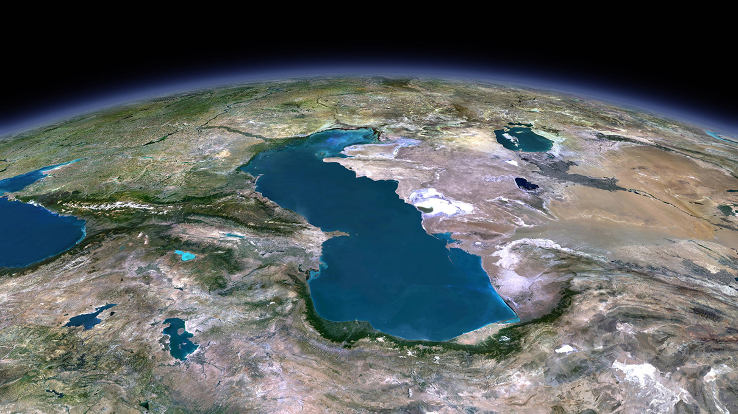
CASPIAN SEA :
The Caspian Sea is the world’s largest inland body of water and is often described as the world’s largest lake despite its name
This sea is bordered by Kazakhstan, Turkmenistan, Iran, Azerbaijan, and Russia

Slide 11
Caspian Sea
Aral Sea
ARAL SEA
Arabian
Sea
Bay of Bengal
Indian Ocean

Slide 12
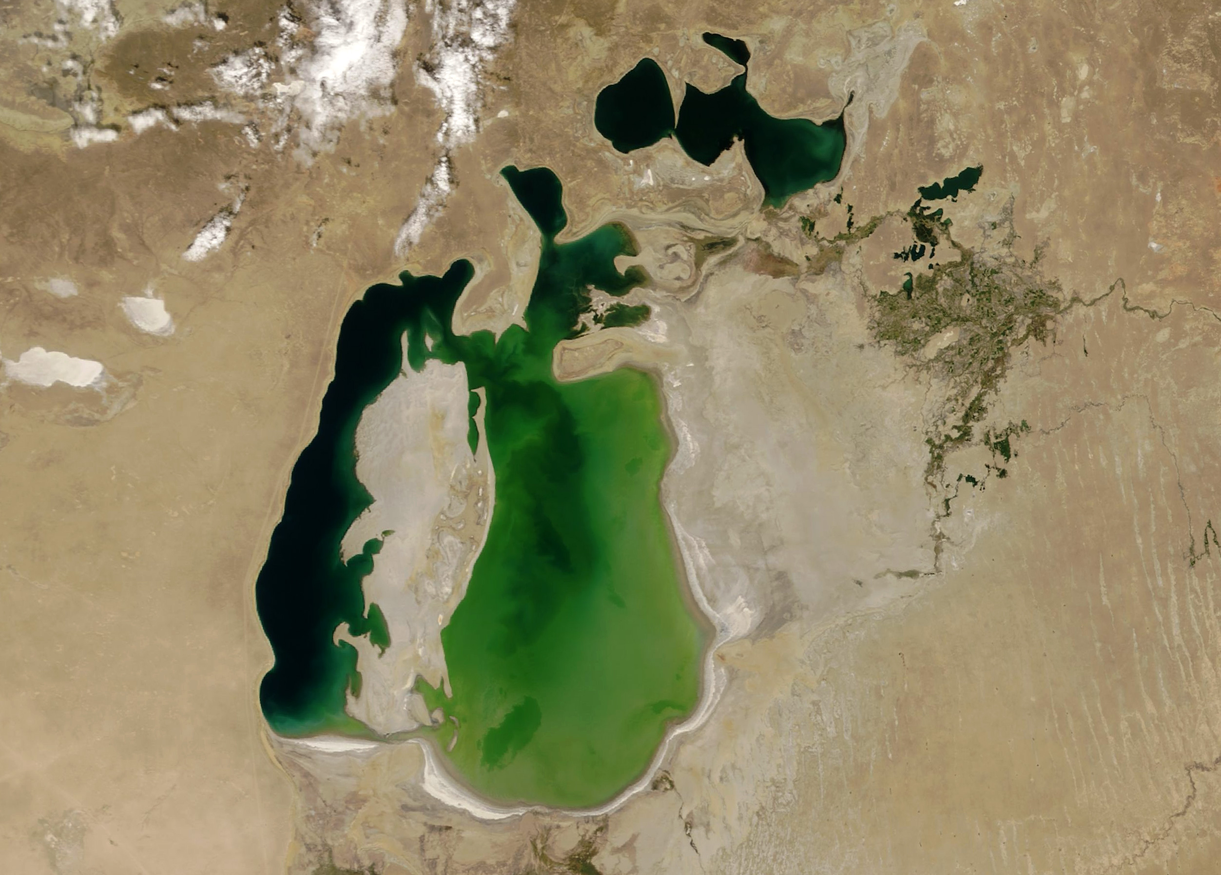
ARAL SEA :
The Aral Sea was a lake lying between Kazakhstan and Uzbekistan which began shrinking in the 1960s and had largely dried up by the 2010s
Its name roughly translates to “Sea of Islands” referring to the 1,100 islands that had dotted its waters

Slide 13
Caspian Sea
Aral Sea
INDUS RIVER
Indus River
Arabian
Sea
Bay of Bengal
Indian Ocean

Slide 14
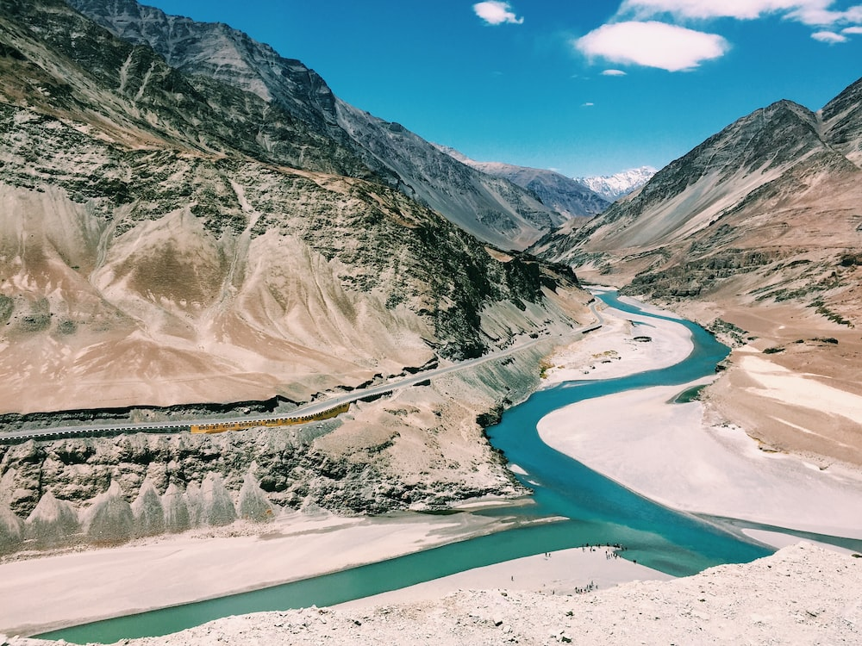
INDUS RIVER :
The Indus River runs for approximately 2,000 miles
270 million people in China, India, and Pakistan depend on this river and its tributaries

Slide 15
Caspian Sea
Aral Sea
GANGES RIVER
Indus River
Ganges River
Arabian
Sea
Bay of Bengal
Indian Ocean

Slide 16
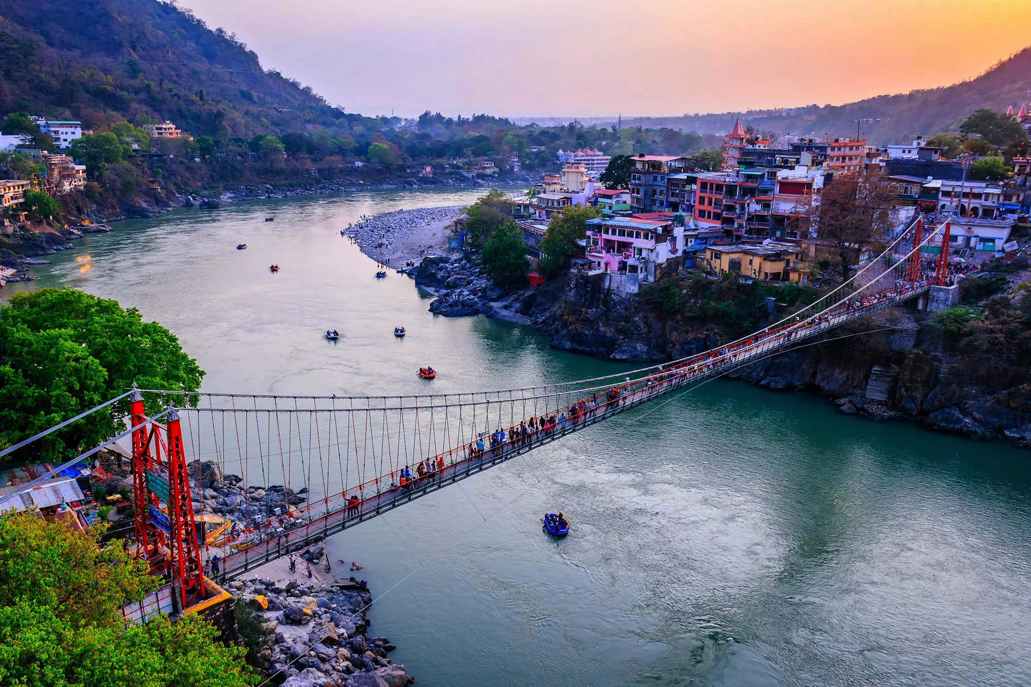
GANGES RIVER :
The Ganges flows for over 1,500 miles from the Himalayas to the Bay of Bengal
This river has been regarded as the holiest of rivers by Hindus. They cast the ashes of their dead into the river, believing that this gives the deceased direct passage to heaven

Slide 17
Caspian Sea
Aral Sea
BRAHMAPUTRA RIVER
Indus River
Brahmaputra River
Ganges River
Arabian
Sea
Bay of Bengal
Indian Ocean

Slide 18
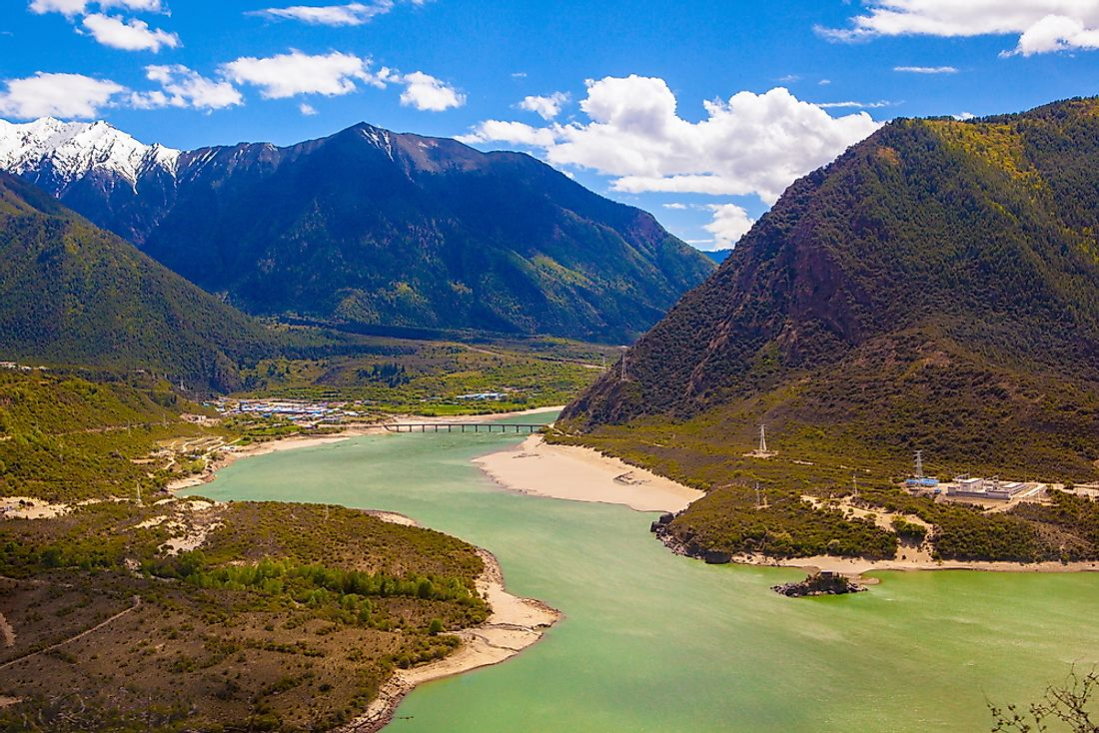
BRAHMAPUTRA RIVER:
This river flows for approximately 1,800 miles from its source in the Himalayan Mountains to its confluence with the Ganges River
This river is very sacred to Hindus and its name means “son of Brahma” in Sanskrit. Brahma is the creator god in Hinduism.

Slide 19
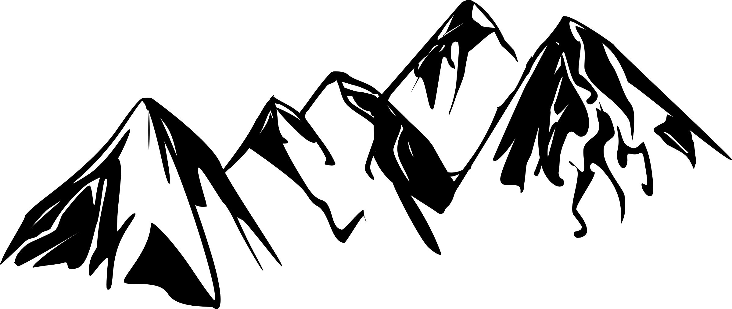
Ural Mts.
Caspian Sea
Aral Sea
URAL MOUNTAINS
Indus River
Brahmaputra River
Ganges River
Arabian
Sea
Bay of Bengal
Indian Ocean

Slide 20
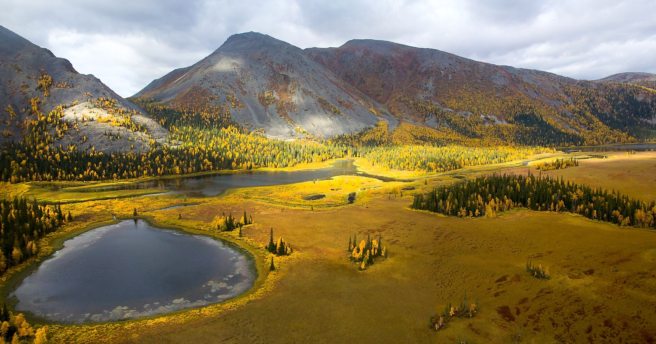
URAL MOUNTAINS:
These mountains, which run ~1,550 miles down Russia, mark the physical border between Europe and Asia
The Ural Mountains are among the oldest mountains in the world at approximately 300 million years old

Slide 21
Ural Mts.
Caspian Sea
Hindu Kush
Aral Sea
HINDU KUSH
Indus River
Brahmaputra River
Ganges River
Arabian
Sea
Bay of Bengal
Indian Ocean

Slide 22
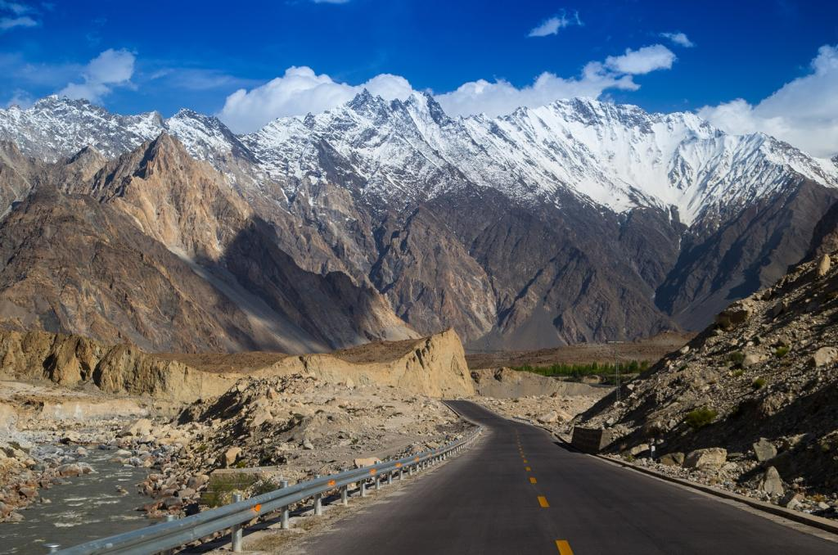
HINDU KUSH :
A 500 mile long mountain range that runs through Afghanistan
Its name translates to “Hindu Killer”
The highest elevation of this mountain range is roughly 25,230 feet tall

Slide 23
Ural Mts.
Caspian Sea
Hindu Kush
Aral Sea
HIMALAYAN MOUNTAINS
Indus River
Himalayan Mts.
Brahmaputra River
Ganges River
Arabian
Sea
Bay of Bengal
Indian Ocean

Slide 24
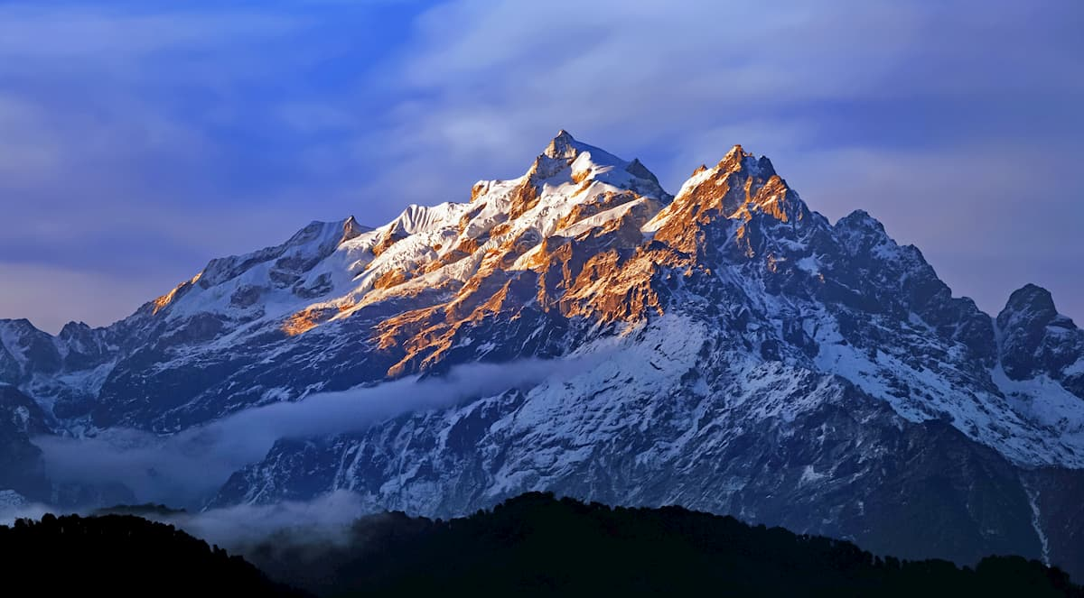
HIMALAYAN MOUNTAINS:
The Himalayas, meaning “snow abode” in Sanskrit, are one of the youngest mountain ranges on Earth
This mountain range contains some of the tallest mountain peaks in the world, including Mt. Everest at over 29,000 feet tall.

Slide 25
Ural Mts.
Caspian Sea
Hindu Kush
Aral Sea
Plateau of Tibet
PLATEAU OF TIBET
Indus River
Himalayan Mts.
Brahmaputra River
Ganges River
Arabian
Sea
Bay of Bengal
Indian Ocean

Slide 26
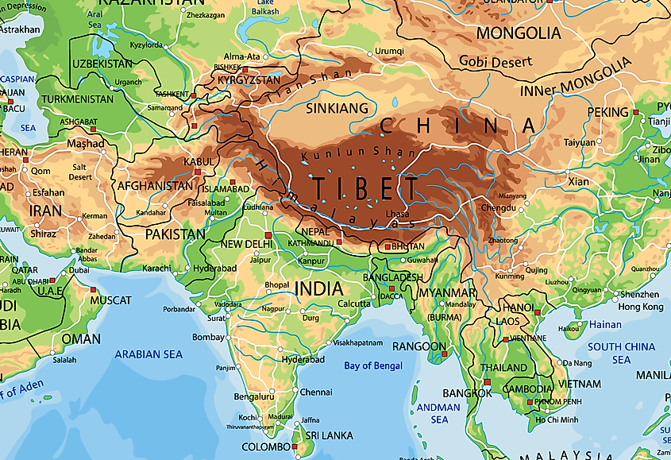
PLATEAU OF TIBET:
The Tibetan Plateau is known as ”the roof of the world” as it’s the highest and largest plateau on Earth
Its elevation ranges from 10,000 to 16,000 feet tall and it covers approximately 970,000 square miles

Slide 27
Ural Mts.
Caspian Sea
Hindu Kush
Aral Sea
Plateau of Tibet
DECCAN PLATEAU
Indus River
Himalayan Mts.
Brahmaputra River
Ganges River
Deccan Plateau
Arabian
Sea
Bay of Bengal
Indian Ocean

Slide 28
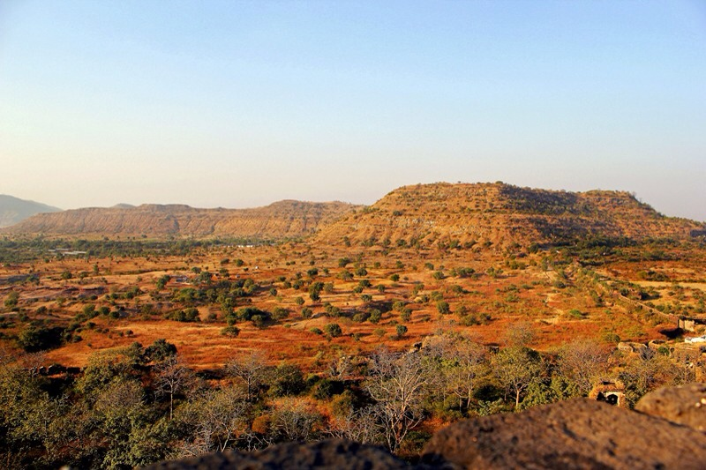
DECCAN PLATEAU:
The Deccan Plateau is a high triangular tableland that covers most of South India
The average elevation of this plateau is 2,000 feet
Its name derives from the Sanskrit word meaning “south”

Slide 29
Ural Mts.
Steppes
Caspian Sea
Hindu Kush
Aral Sea
STEPPES
Plateau of Tibet
Indus River
Himalayan Mts.
Brahmaputra River
Ganges River
Deccan Plateau
Arabian
Sea
Bay of Bengal
Indian Ocean

Slide 30
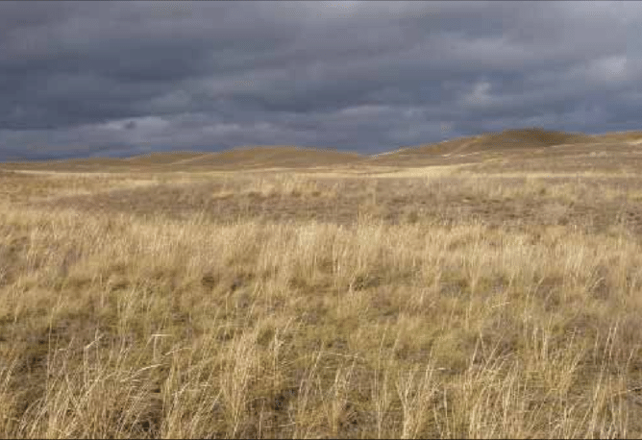
STEPPES :
The Steppes are a dry, grassy plains region that runs through Eurasia
This area has a semi-arid climate with cold winters and warm summers. As a result, it does not receive enough rainfall for trees to grow here

Slide 31
Ural Mts.
Steppes
Caspian Sea
Hindu Kush
Aral Sea
Plateau of Tibet
CENTRAL & SOUTH ASIA
Indus River
Himalayan Mts.
Brahmaputra River
Ganges River
Deccan Plateau
Arabian
Sea
Bay of Bengal
Indian Ocean

